Slide 1
Topographies of Contact:
Native Americans and Europeans at the Confluence

Slide 2
Map of the Confluence
c. 1756

Slide 3
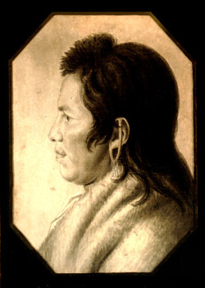
Andrew Montour
Son of Madame Montour and Oneida father
c. 1700-1772
1742 meets with Count Zinzendorf

Slide 4
Shamokin Diary
Community diary held in Moravian Archives, Bethlehem, Pa
1744-1755

Slide 5
1747
Minutes of the conference with Shikellamy that lays out the terms of the Moravian settlement in Shamokin

Slide 6
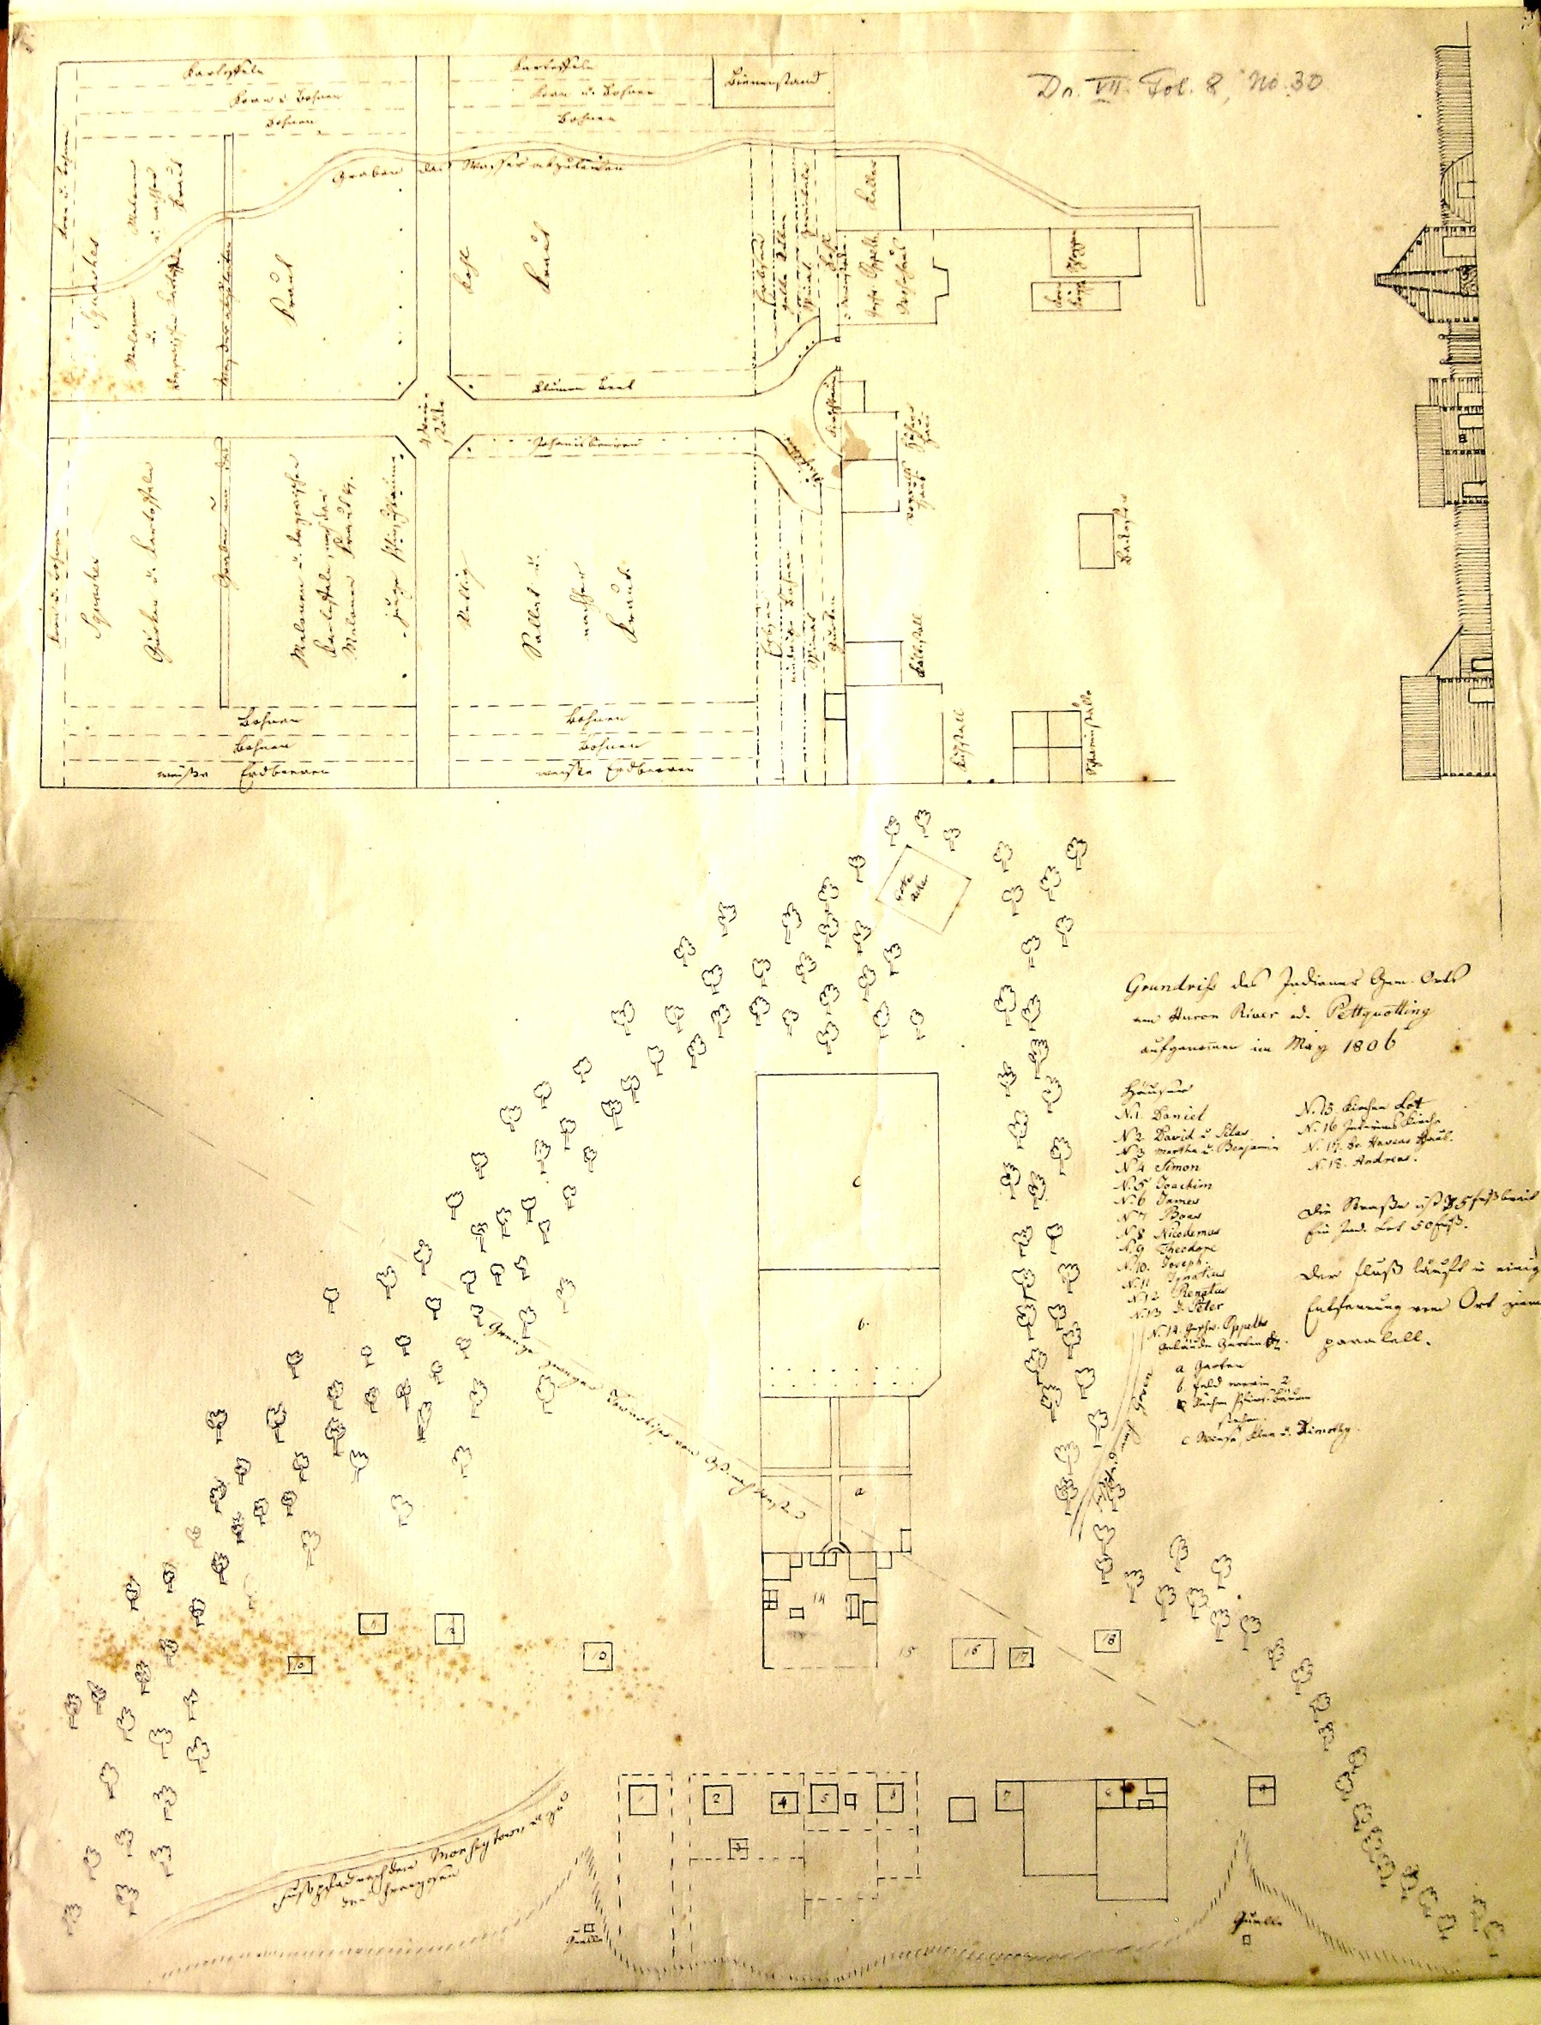
Moravian Indian congregation
On the Huron River
Map by John Heckewelder

Slide 7
Friedenshütten 1768

Slide 8
Measuring the lots…

Slide 9
Shamokin Diary

Slide 10
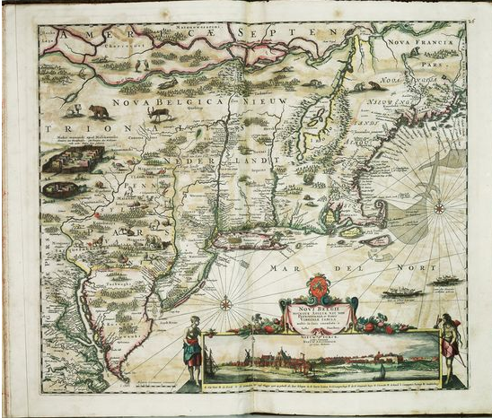
Novi Belgii. copperplate engraving with original hand color.
By Justus Danckers. c. 1690. 22" x 19"

Slide 11
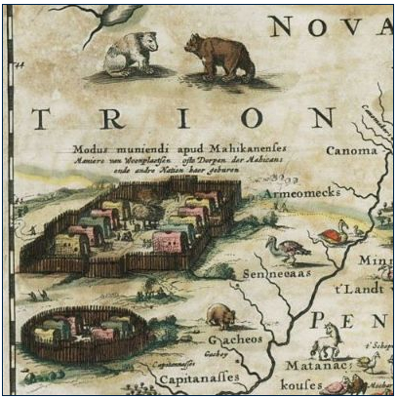

Slide 12
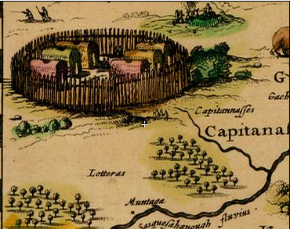

Slide 13
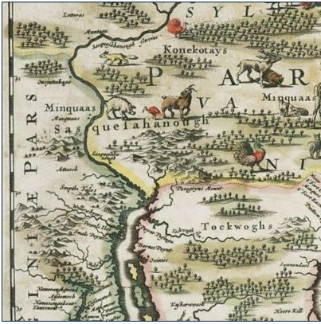
The Chesapeake of Captain John Smith

Slide 14
Ludwig von Zinzendorf 1700-1760
Born into an aristocratic family
Raised in the Pietist tradition
Attended university in Wittenberg--seat of German Pietism
Studied with Francke
Met with missionaries in Halle and also with a Caribbean former slave Anton
Moravian Missions
Notes:
Count Nicholas Ludwig von Zinzendorf was born in Dresden, capital of Saxony in 1700. Zinzendorf was a descendent of Protestant Austrian nobility, and was raised by his grandmother, Henriette Catharine von Gersdorf after his father’s death and his mother’s remarriage. His grandmother, an educated and talented woman, exercised great influence on the politics and pietism of the day. Philipp Jakob Spener, August Hermann Francke, Karl Hildebrand Canstein, and Paul Anton, the major proponents of the Halle school of Pietism, were all welcome guests at her castle of Großhennersdorf. Zinzendorf was educated at Francke’s school in Halle. In 1716, Zinzendorf was sent to the University of Wittenberg, the bastion of Lutheran Orthodoxy, to study law, although his interests and passion grew more and more to be the study of theology.
The eighteenth century saw a vast emigration of Germans to America, in search of financial wealth, religious and political freedom. By 1727, already over 20,000 Germans had settled in Pennsylvania. And for these settlers clearly the problem of how to interact with the native inhabitants of the area was of paramount importance. In order answer all questions for the future emigrant, in 1702 Daniel Falckner sat down in Halle with August Hermann Francke and answered his 103 questions on subjects as far ranging as where the other Germans lived, to how the Indians might be subdued. Falckner, having lived in central Pennsylvania, was called to Halle to report on the condition of the province of Pennsylvania for possible settlement by the Pietists being persecuted in Saxony. He described the Indians of Pennsylvania to as simple, vengeful, akin to apes in their upbringing of their children, suspicious of capture, speaking an unsophiscated language consisting of „no more words than things” and adhering to a Manichaeistic religion worshipping a god of both good and evil. Eight years after Falckner’s report to Francke, the future leader of the Moravian Church, Count Nicholas Ludwig von Zinzendorf, entered the Francke’s Pedagogium in Halle. During his six years there he met his first missionaries who had returned from Tranquebar, and most likely read Falckner’s “Curieuse Nachricht von Pennsylvania”. In 1732, even before he sent his own missionaries out into the field, Zinzendorf outlined his mission theology in a letter sent to Johann Ernst Geister, a missionary sent to Madras by the Stollberg Konsistorium. In this letter, he advises Geister of the appropriate demeanor towards the non-Christian. Zinzendorf writes,
_ Julius Sachse, Falckers Curiuese Nachricht von Pennsylvania: the book that stimualted the Great German Emigration to Pennsylvania in the Early Years of the 18th Century. Edited and Translated by Jumius Friedrich Sachse, (Philadephia: printed for the Author, 1905.)
Show a happy and lively spirit and in external matters do not rule over the heathen in the slightest fashion, but rather gain respect among them through the strength of your spirit, and in external matters humble yourself below them as much as possible.
_ As quoted in Zinzendorf, Texte zur Mission, 37.
Zinzendorf was well aware of the problems missionaries had already encountered in their contacts with other cultures, problems he attributed to the attitude missionaries had adopted towards the non-Christian. For example, Zinzendorf claimed that the refusal of some missionaries to mix with the non-Christians, or to live at their level of poverty, was contrary to the spirit of Christ. Missionaries and non-Christians alike should both show deference only to the invisible Savior. In another speech to the inhabitants of St. Thomas held in Creole on February 15, 1739 Zinzendorf clearly delineated both his understanding of the natural state of sin into which the heathen have been born and their need for salvation from the inherently sinful characteristics of this state. To convert the non-Christian is both to extend the kingdom of God and also to create another instance, unique and unrepeatable, of a Vergegenwärtigung, a making present of Christ. This understanding of mission policy meant that baptisms were individual and not performed en masse, that the individual’s path to salvation was charted by means of frequent “speakings” with spiritual Helpers from the same national background as the candidate and the missionaries, and that each convert was a member of a small group of people who came together regularly in the evenings to discuss their spiritual growth, exchange confidences about their personal problems, encourage and forgive each other, and help each other toward Christ.
Such an individualistic approach toward conversion had both its benefits and drawbacks. The benefits showed themselves in the success of the missions.

Slide 15
Missions to North America
Method of conversion
Exorcism needed before baptism
Common European prejudice that American Indians were primitive and their language could not support abstract notions

Slide 16
Moravian Missions in Colonial Pennsylvania

Slide 17
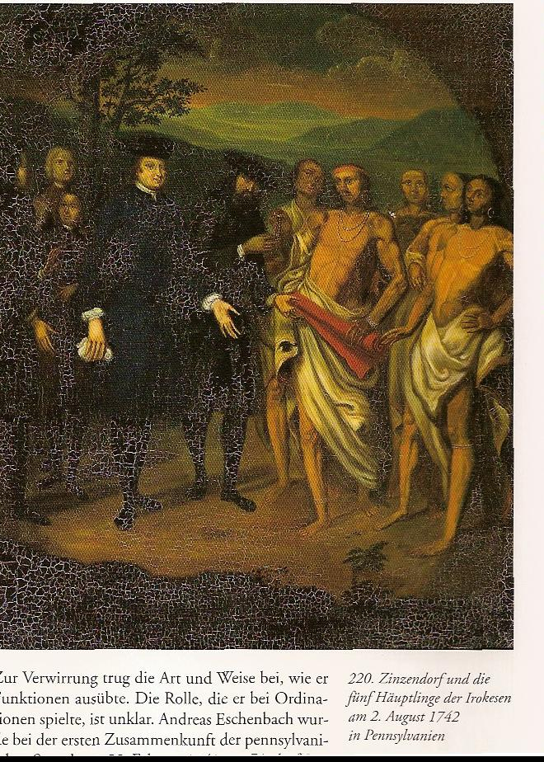

Slide 19
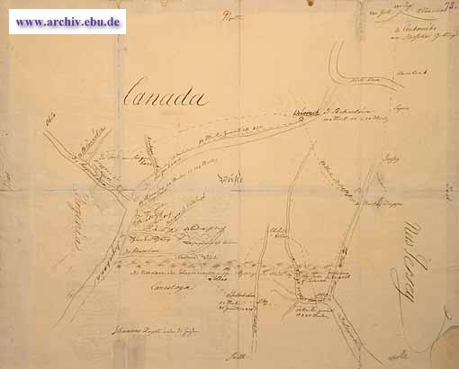
Johanans Reisen unter die Heyden Karte der drei Missionsreisen des Grafen N. L. von Zinzendorf in Pennsylvania mit Entfernungsangaben 1742

Slide 20
Zinzendorf’s hand drawn map 1742

Slide 21
Nature, Natives, and the Sublime
Thomas Cole, Scenes from Last of the Mohicans

Slide 22
The Mission Diary

Slide 23
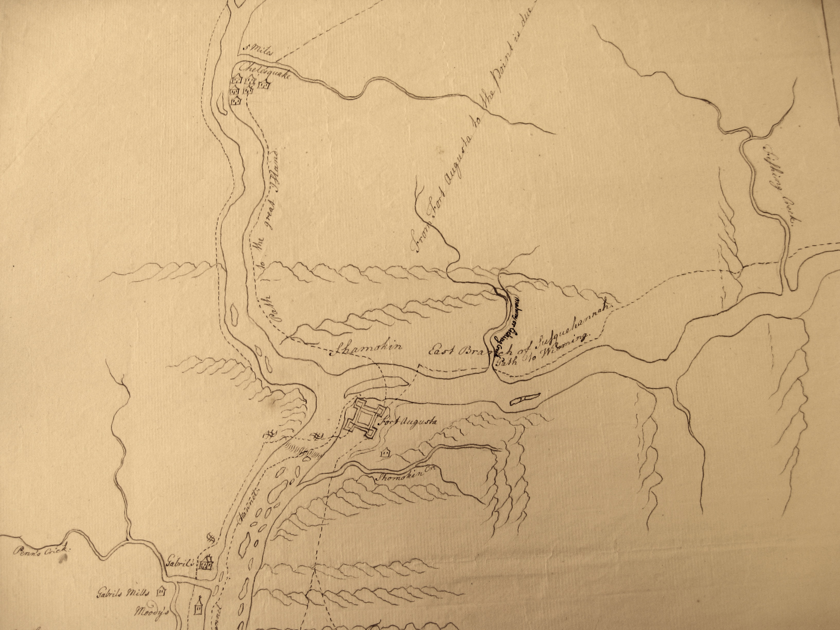

Slide 24
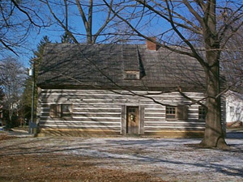
Shikellamy and the Moravians

Slide 25
Northumberland County Historical Society

Slide 26
A Sense of the Susquehanna…

